Slide 1
Enterprise Analytics
Pre-MTAC Webinar
November 2017

Slide 2
Informed Visibility® Update

Slide 3






Informed Visibility® Update
November 30
Migration from IMb Tracing to IV – our single source for next day data
December 31
IMb Tracing retired
COMMUNICATION COMMUNICATION
THANK YOU to those who have migrated!
COMMUNICATION COMMUNICATION
IS HERE!
December 11
customer schedules removed from
IMb tracing
Over 400 new mailers joined IV since July 1
December 1
IV becomes the single source for Mail Visibility, Reporting & Tracking
November 27
Announced path forward for customers with mitigating circumstances
November 30
Last day to migrate from legacy to IV unless mitigating circumstances provided to USPS
Notes:
Nov 30
Single source/next day
-IV here
-thank you to all who migrated
it’s been a journey
- good news
- since 6/1 over 400 new mailers joined IV
- we’ve done a lot of communicating with industry
- we have a path for ward for cust who can’t meet deadline
- reminder that 12/11 we’ll start removing cust schedules from IMB tracing and will retire IMBT on 12/31

Slide 4
Informed Visibility Roadmap
November 2017
more user-friendly and provide sortation and export of tabs within the different areas of the application
new enhancements follow a cadence of review, demo and documentation provided prior to the release
Sub Group of Informed Visibility users established to help define the path forward
established a proposed cadence of application updates with the UG 4 Sub Group in October and presented to the industry on 10/27 and 11/01
Informed Visibility releases for any enhancements
2018
Notes:
Informed Visibility releases for any enhancements are scheduled beyond January 1 of 2018.
The releases for November included changes requested by industry.
Changes were to make application more user-friendly and provide sortation and export of tabs within the different areas of the application.
New enhancements will follow a cadence of review, demo and documentation provided prior to the release.
We established a Sub Group of Informed Visibility users to help define the path forward.
We established a proposed cadence of application updates with the UG 4 Sub Group in October and presented this to the industry in the larger meeting (see next slide) on 10/27 and 11/01.

Slide 5
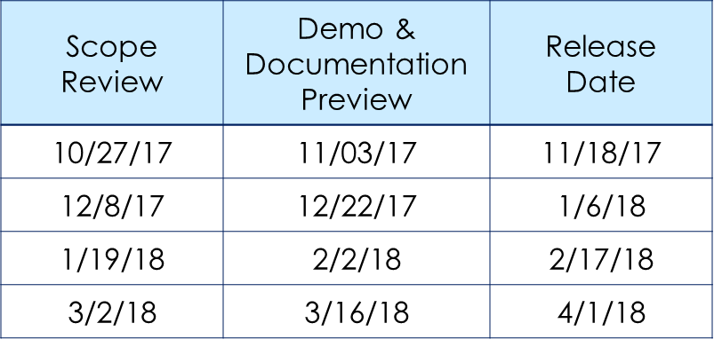
Informed Visibility Roadmap
Proposed Cadence of Application
Scope Review will be provided 4 weeks prior and will include:
Web changes – review wireframes
Data changes – review new fields that will be available
Demo and Documentation Preview will provided 1 - 2 weeks prior and include:
  Updates to User Guide
  Updates to Data Feed
  Specifications:
    Data Dictionary
    Sample Files /
    xml Messages,
    any new Op Codes

Slide 6
Manual Bullpen

Slide 7
Manual Bullpen Visibility
Operation Numbers: Current Proposal
Operation 110 – Initial Breakdown
  Currently vetting process and reporting with Operations
Operation 126 – Dispatch
  This is a Mail Consolidation operation in preparation for dispatch. It is not intended for mail that flows directly from machine to dock door.
  Vetting process with Operations is COMPLETE
Nesting and Visibility
Proof-Of-Concept testing underway in two plants (Two scanner solutions)
  Scanning Container Placards or Tray/Sack Labels > Nesting
Dependencies:
  Full Service Mailings
  eDoc Accuracy and Barcode Readability
Challenges relative to “Turnaround” Mail – Mailer is dropping Handling Units from eDoc at Delivery Units as well as origin plant

Slide 8
Mail Inventory & Predictive Workloads

Slide 9
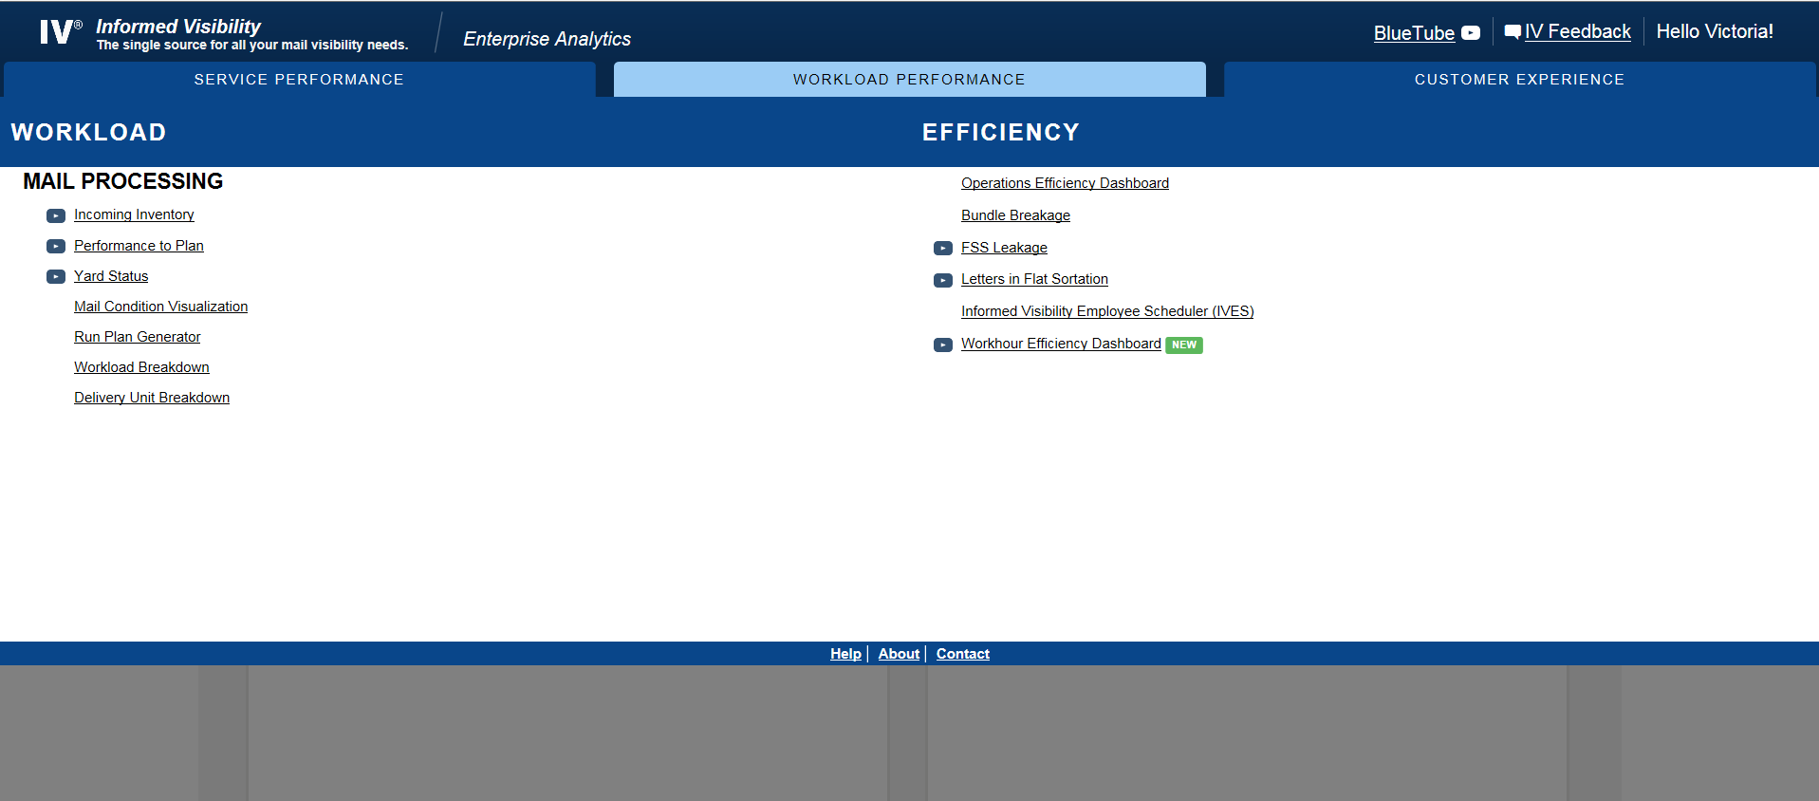
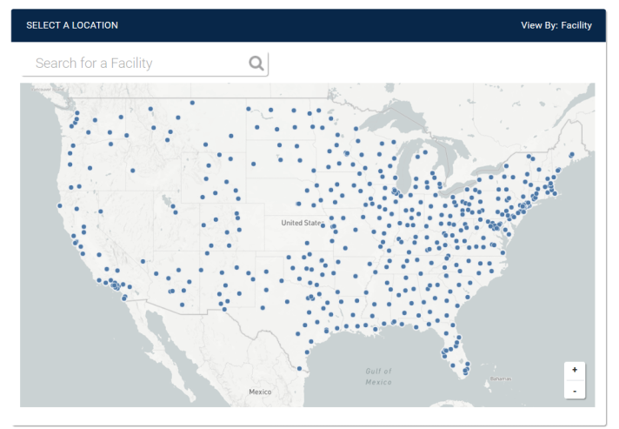
Mail Inventory & Predictive Workloads
Current State
Deployed six visualizations in
Fiscal Year (FY) 2017
  Mail Condition Visualization (MCV)
  Performance to Plan (P2P)
  Intelligent Plan Generator (IPG)
  Incoming Inventory
  WorkloDelivery ad Breakdown
  Unit Breakdown (DUB)
Deployed Mail Visualization Applications:
  Mail History
  Enhanced Barcode Diagnostics
Continued to enhance visualizations to
improve visibility
Future State
Scheduled to enhance current visualizations and deploy new applications in FY 2018.
Mail Inventory & Predictive Workloads

Slide 10
IMb Planning Tool

Slide 11
IMb Planning Tool
Progress Update
Issue
Resolution
Required ColdFusion license upgrade to resolve production issue
Testing and production deployment targeted for December 5, 2017

Slide 12
Mail Visibility Applications (MVA)

Slide 13

Mail Visibility Applications (MVA)
Recently Launched for FY2017 Peak Season Delivery
Platform developed to leverage technology to improve operational efficiencies.
Two applications supported by MVA include:
      Mail History Application
  Employees can use mobile devices to retrieve near real-time delivery information by scanning barcodes for containers, mail handling units, and single pieces. By automating mail prioritization, the Postal Service anticipates an increase in productivity and improvement to customer service by performing the following:
    Managing mail
    Prioritizing mail by using the Color Code or the Earliest Delivery Date information
    Dispositioning Mail
    Finding specific Mailer Identification
    Identifying looping mail
    Determining when, where, and what device scanned the container, tray or mailpiece
    Attaining information about mail – up to 40 data elements displayed
      Enhanced Barcode Diagnostics Application
  Employees can use mobile devices to scan barcodes to provide analysis of the visible elements of the barcodes scanned. This barcode parsing tool highlights invalid data elements such as the barcode length or symbology on the mobile device, helping users to more efficiently process mail.
IV Mail Inventory & Predictive Workloads

Slide 14



Mail Visibility Applications (MVA)
High Level Schedule
  Trailer Visibility (TV) – on hold
  Mailer Visibility (MV) – on hold
  Enhanced Barcode Diagnostics (EBD) – on hold
SIT
CAT
Aug ‘17
Sep ‘17
TV
MV
SIT
Aug ‘17
Sep ‘17
EBD

Slide 15
Bundle Visibility

Slide 16
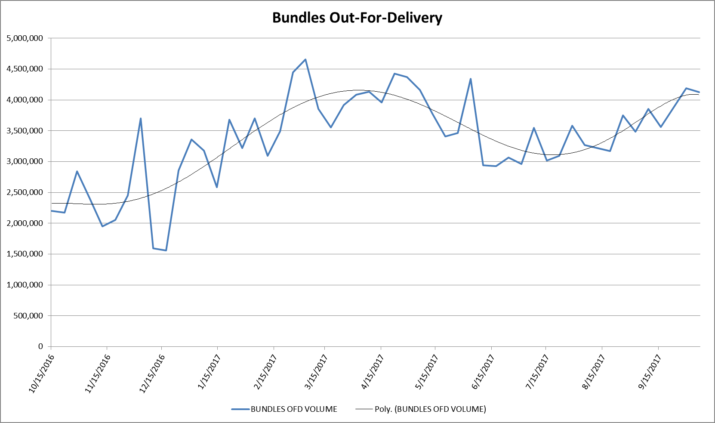
Bundle Visibility – Program Status
Status: Continue to expand and enhance:
Bundle Visibility
    Enabled nesting on new equipment (SPSS / HTPS)
    Enabling nesting to and distribution from sacks
    Additional diagnostics for field personnel
    Utilizing IV tools to readily identify and resolve issues
Performance and Reliability
    Diagnostic Training for Subject Matter Experts
    Continued field training (with certification) and created training videos
    Updating of Service Talks and Visual Aids
    Driving scanning behavior relative to direct containers either DDU or plant dropped
    Continued focus on accurate placarding with exception reports to identify impact offices
Weekly Averages
Averaging weekly (07/01/2017 – 09/30/2017):
91.1%
and
5.3 million
bundles nested per week
(Plants)
84.3%
and
3.8 million
bundles distributed
(DUs)
*(Filtered for Surface Visibility Plants Service Area)

Slide 17
Mail in Measurement

Slide 18
Mail In Measurement
First-Class Mail®

Slide 19
FY17 Q4 Commercial Mail Volume
Mail In Measurement
In FY17 Q4, over 77% of Full-Service mail was in Measurement
Mail Class | Mail Shape | Commercial | Full-Service Eligible | Full-Service | In Measurement | % of Full-Service In Measurement
First Class Presort | Letter/Card | 9,157,518,125 | 8,791,290,029 | 8,282,380,822 | 6,011,484,249 | 72.58%
First Class Presort | Flat | 148,064,258 | 131,624,600 | 111,737,817 | 78,096,181 | 69.89%
USPS Marketing | Letter | 12,807,440,978 | 12,553,844,307 | 11,672,730,146 | 9,617,141,505 | 82.39%
USPS Marketing | Flat | 5,318,758,209 | 3,168,917,836 | 2,811,131,442 | 2,152,861,434 | 76.58%
Periodicals | Flat | 1,156,658,810 | 1,112,049,671 | 948,885,655 | 692,671,328 | 73.00%
Total |  | 28,588,440,380 | 25,757,726,443 | 23,826,865,882 | 18,552,254,697 | 77.86%
Note: Metrics are for Mailing Dates 7/1/2017 – 9/30/2017
Commercial and Full-Service Eligible Volumes sourced from PostalOne!
Notes:
19

Slide 20
Full Service Mail Trend
In September 2017, 92% of Commercial mail
eligible for Full-Service was Full-Service.
Note: Below graph depicts FS Adoption % as an avg. for the quarter; Slide title depicts the % for the latest month.
Notes:
The chart depicts the quarterly trend of Full Service Adoption as a % of all commercial mail that is eligible for the Full-Service discount.

Slide 21
First-Class Mail® (Letters)
Volume In Measurement
In September 2017, 64% of Commercial First-Class Letters were in measurement. Over 1.9 Billion pieces were measured.
Basic (FS Eligible) Breakdown:
• 53% of this mail is associated with
existing Full-Service Mailers
• 47% of this mail is associated with
Non Full-Service Mailers
Notes:
The pie chart depicts the breakdown of the total Commercial mail volume for the specified month.
FS in Measurement: % of total mail that is Full Service and in measurement
FS Not in Measurement: % of total mail that is Full Service and not in measurement
Basic (FS Eligible): % of total mail that is Basic Service and is eligible for Full Service
Basic (Non-FS Eligible): % of total mail that is Basic Service and is not eligible for Full Service

Slide 22
First-Class Mail® (Letters)
Reasons why mail is not in measurement
In September 2017, 29% of Full-Service First-Class Letters were excluded from measurement.
Attributed to Mailers | 13.14%
Attributed to USPS / Unknown | 86.86%
Exclusion Reason | % of Excluded | % of Total*
Long Haul | 41.86% | 13.71%
No Start-the-Clock | 34.17% | 11.19%
No Piece Scan | 9.09% | 2.98%
Undeliverable-as-Addressed / PARS | 4.73% | 1.55%
Incorrect Entry Facility | 2.75% | 0.90%
Non-Unique IMb | 2.44% | 0.80%
Orphan Handling Unit | 1.55% | 0.51%
Inconsistent SPM Data | 1.31% | 0.43%
Non-Compliant | 0.52% | 0.17%
Other | 1.58% | 0.53%
* Mail can be excluded due to more than one reason. As a result, the sum of individual exclusion percentages (33%) is greater than the overall percentage of mail not in measurement (29%)
Notes:
The pie chart depicts the breakdown of Full Service mail volume in measurement and not in measurement for the specified month.
Pieces in Measurement: % of total Full Service mail that is in measurement
Exclusion reasons: % of each of the top reasons why Full Service mail is not in measurement.
Attributed to Mailers: % of exclusions that can definitively be attributed to Mailer issues.
Unable to attribute to Mailers: % of exclusions that cannot definitively be attributed to Mailer issues.
The exclusion breakdown table depicts the top reasons for Full Service Mail volume to not be in measurement along with the associated volume %.
Reason: A short description of the reason why mail is excluded
% of Excluded: % of the total excluded mail volume each reason constitutes
% of Total: % of the total mail volume each reason constitutes

Slide 23
First-Class Mail® (Flats)
Volume In Measurement
In September 2017, 52% of Commercial First-Class Flats were in measurement. Over 26 Million pieces were measured.
Basic (FS Eligible) Breakdown:
• 68% of this mail is associated with
existing Full-Service Mailers
• 32% of this mail is associated with
Non Full-Service Mailers
Notes:
The pie chart depicts the breakdown of the total Commercial mail volume for the specified month.
FS in Measurement: % of total mail that is Full Service and in measurement
FS Not in Measurement: % of total mail that is Full Service and not in measurement
Basic (FS Eligible): % of total mail that is Basic Service and is eligible for Full Service
Basic (Non-FS Eligible): % of total mail that is Basic Service and is not eligible for Full Service

Slide 24
First-Class Mail® (Flats)
Reasons why mail is not in measurement
In September 2017, 31% of Full-Service First-Class Flats were excluded from measurement.
Attributed to Mailers | 10.22%
Attributed to USPS / Unknown | 89.78%
Exclusion Reason | % of Excluded | % of Total*
No Start-the-Clock | 35.90% | 12.93%
No Piece Scan | 31.09% | 11.20%
Long Haul | 21.21% | 7.64%
Undeliverable-as-Addressed / PARS | 3.08% | 1.11%
Non-Unique IMb | 2.75% | 0.99%
Incorrect Entry Facility | 2.09% | 0.75%
Invalid Final Processing ZIP5 | 0.76% | 0.28%
Inaccurate Scheduled Ship Date | 0.68% | 0.24%
Non-Unique Physical IMcb | 0.67% | 0.24%
Other | 1.77% | 0.64%
* Mail can be excluded due to more than one reason. As a result, the sum of individual exclusion percentages (36%) is greater than the overall percentage of mail not in measurement (31%)
Notes:
The pie chart depicts the breakdown of Full Service mail volume in measurement and not in measurement for the specified month.
Pieces in Measurement: % of total Full Service mail that is in measurement
Exclusion reasons: % of each of the top reasons why Full Service mail is not in measurement.
Attributed to Mailers: % of exclusions that can definitively be attributed to Mailer issues.
Unable to attribute to Mailers: % of exclusions that cannot definitively be attributed to Mailer issues.
The exclusion breakdown table depicts the top reasons for Full Service Mail volume to not be in measurement along with the associated volume %.
Reason: A short description of the reason why mail is excluded
% of Excluded: % of the total excluded mail volume each reason constitutes
% of Total: % of the total mail volume each reason constitutes

Slide 25
Mail Not In Measurement
Exclusion Reason Descriptions
Exclusion Reason | Exclusion Description | Mailer Attributed
Invalid Entry Point for Entry Discount (FAST MDF) | Entry Point for Entry Discount claimed in eDoc is invalid for the entry point and destination of the mail | Y
Incorrect Entry Facility | eDoc entry facility does not match the facility specified in the associated FAST Appointment | Y
Non-Unique IMb | eDoc contains mail pieces with a non-unique IMb | Y
Undeliverable-as-Addressed / PARS | Undeliverable-as Addressed (UAA) mail as indicated by ACS and/or PARS operation when mail piece is processed | Y
Inaccurate Scheduled Ship Date | eDoc scheduled ship date time is 48+ hours earlier than the postage statement finalization date time | Y
FAST Appointment Irregularity | Irregularity with the mailing/trip captured by FAST (e.g. contents not matching 8125) | Y
Non-Unique Physical IMcb | Physical containers with non-unique IMcb on the placard | Y
Orphan Handling Unit | Mail piece associated to an Orphan Handling Unit (e.g. loose tray) that is not inducted at a Business Mail Entry Unit | Y
Non-Compliant | Mailing/Mailer identified as non-compliant due to inaccuracies in mail preparation OR Mailer in 6-week monitoring period for new mailers | Y
Invalid Container Level for Entry | The 3-Digit (FSS Facility) pallet was entered directly at a DFSS site | Y
No Piece Scan | No automation scan observed for the mail piece | N
No Start-the-Clock | Lack of a container unload scan or inability to identify the FAST appointment associated to the container | N
Long Haul | Mail verified at a DMU then transported by USPS to a mail processing facility in a different district than the DMU | N
Inconsistent SPM data | Mail piece received inconsistent scan events when calculating SPM (container/mail piece scans not in chronological order) | N
Excluded ZIPs | Excluded from SPM due to 3 digit delivery ZIPs that are not measured | N

Slide 26
No Start-the-Clock

Slide 27
Incorrect Entry Facility

Slide 28
Undeliverable-as-Addressed / PARS

Slide 29
Non-Unique IMb

Slide 30
Inaccurate Scheduled Ship Date

Slide 31
Long Haul

Slide 32
No Piece Scan

Slide 33
Increase Mail In Measurement
Approach

Slide 34
Increase Mail In Measurement
Oct - Ongoing
Field use of tools to decrease exclusions throughout FY 2018
Mar Compiled the top 3 exclusion reasons for each mail class/shape
May-Jun
Developed two tools to replicate team successes to Field operations
Nov
L601 labeling list updated for NDC EPFED
Aug-Sep National kick-off for District engagement with the tools to decrease exclusions
Mar – Apr
Analyzed and resolved exclusions using a cross-functional USPS HQ team working with mailers & postal sites
May-Jun
Pilot tested the two tools in the Field
Nov
Update to Southern Area STC facility reference
Mar
Apr
May
Jun
Jul
Aug
Sep
Oct
Nov

Slide 35
Mail In Measurement
Marketing Mail

Slide 36
FY17 Q4 Commercial Mail Volume
Mail In Measurement
In FY17 Q4, over 77% of Full-Service mail was in Measurement
Mail Class | Mail Shape | Commercial | Full-Service Eligible | Full-Service | In Measurement | % of Full-Service In Measurement
First Class Presort | Letter/Card | 9,157,518,125 | 8,791,290,029 | 8,282,380,822 | 6,011,484,249 | 72.58%
First Class Presort | Flat | 148,064,258 | 131,624,600 | 111,737,817 | 78,096,181 | 69.89%
USPS Marketing | Letter | 12,807,440,978 | 12,553,844,307 | 11,672,730,146 | 9,617,141,505 | 82.39%
USPS Marketing | Flat | 5,318,758,209 | 3,168,917,836 | 2,811,131,442 | 2,152,861,434 | 76.58%
Periodicals | Flat | 1,156,658,810 | 1,112,049,671 | 948,885,655 | 692,671,328 | 73.00%
Total |  | 28,588,440,380 | 25,757,726,443 | 23,826,865,882 | 18,552,254,697 | 77.86%
Note: Metrics are for Mailing Dates 7/1/2017 – 9/30/2017
Commercial and Full-Service Eligible Volumes sourced from PostalOne!
Notes:
36

Slide 37
Full Service Mail Trend
In September 2017, 92% of Commercial mail eligible for Full-Service was Full-Service.
Note: Below graph depicts FS Adoption % as an avg. for the quarter; Slide title depicts the % for the latest month.
Notes:
The chart depicts the quarterly trend of Full Service Adoption as a % of all commercial mail that is eligible for the Full-Service discount.

Slide 38
USPS Marketing Mail*® Letters
Volume In Measurement
In September 2017, 73% of Commercial USPS Marketing Mail* Letters were in measurement. Almost 3.3 Billion pieces were measured.
Basic (FS Eligible) Breakdown:
• 55% of this mail is associated with
existing Full-Service Mailers
• 45% of this mail is associated with
Non Full-Service Mailers
*Prior to FY17 Q2, USPS Marketing Mail was referred to as Standard Mail
Notes:
The pie chart depicts the breakdown of the total Commercial mail volume for the specified month.
FS in Measurement: % of total mail that is Full Service and in measurement
FS Not in Measurement: % of total mail that is Full Service and not in measurement
Basic (FS Eligible): % of total mail that is Basic Service and is eligible for Full Service
Basic (Non-FS Eligible): % of total mail that is Basic Service and is not eligible for Full Service

Slide 39
USPS Marketing Mail*® Letters
Reasons why mail is not in measurement
In September 2017, 20% of Full-Service USPS Marketing Mail* Letters were excluded from measurement.
Attributed to Mailers | 24.06%
Attributed to USPS / Unknown | 75.94%
Exclusion Reason | % of Excluded | % of Total*
No Start-the-Clock | 48.12% | 10.60%
No Piece Scan | 26.28% | 5.79%
Invalid Entry Point for Entry Discount (FAST MDF) | 8.77% | 1.93%
Undeliverable-as-Addressed / PARS | 6.12% | 1.35%
Non-Unique IMb | 2.75% | 0.61%
Incorrect Entry Facility | 1.47% | 0.32%
Non-Unique Physical IMcb | 1.40% | 0.31%
FAST Appointment Irregularity | 1.10% | 0.24%
Inconsistent SPM Data | 0.85% | 0.19%
Other | 3.14% | 0.68%
* Mail can be excluded due to more than one reason. As a result, the sum of individual exclusion percentages (22%) is greater than the overall percentage of mail not in measurement (20%)
*Prior to FY17 Q2, USPS Marketing Mail was referred to as Standard Mail
Notes:
The pie chart depicts the breakdown of Full Service mail volume in measurement and not in measurement for the specified month.
Pieces in Measurement: % of total Full Service mail that is in measurement
Exclusion reasons: % of each of the top reasons why Full Service mail is not in measurement.
Attributed to Mailers: % of exclusions that can definitively be attributed to Mailer issues.
Unable to attribute to Mailers: % of exclusions that cannot definitively be attributed to Mailer issues.
The exclusion breakdown table depicts the top reasons for Full Service Mail volume to not be in measurement along with the associated volume %.
Reason: A short description of the reason why mail is excluded
% of Excluded: % of the total excluded mail volume each reason constitutes
% of Total: % of the total mail volume each reason constitutes

Slide 40
USPS Marketing Mail*® Flats
Volume In Measurement
In September 2017, 42% of Commercial USPS Marketing Mail* Flats were in measurement. Over 800 Million pieces were measured.
Basic (FS Eligible) Breakdown:
• 52% of this mail is associated with
existing Full-Service Mailers
• 48% of this mail is associated with
Non Full-Service Mailers
*Prior to FY17 Q2, USPS Marketing Mail was referred to as Standard Mail
Notes:
The pie chart depicts the breakdown of the total Commercial mail volume for the specified month.
FS in Measurement: % of total mail that is Full Service and in measurement
FS Not in Measurement: % of total mail that is Full Service and not in measurement
Basic (FS Eligible): % of total mail that is Basic Service and is eligible for Full Service
Basic (Non-FS Eligible): % of total mail that is Basic Service and is not eligible for Full Service

Slide 41
USPS Marketing Mail*® Flats
Reasons why mail is not in measurement
In September 2017, 26% of Full-Service USPS Marketing Mail* Flats were excluded from measurement.
Attributed to Mailers | 28.18%
Attributed to USPS / Unknown | 71.82%
Exclusion Reason | % of Excluded | % of Total*
No Piece Scan | 51.41% | 15.27%
No Start-the-Clock | 14.81% | 4.40%
Invalid Entry Point for Entry Discount (FAST MDF) | 12.90% | 3.83%
Invalid Container Level for Entry | 5.88% | 1.75%
Invalid Final Processing ZIP5 | 4.44% | 1.32%
Miscellaneous Reasons | 3.29% | 0.98%
Non-Unique IMb | 1.28% | 0.38%
Incorrect Entry Facility | 1.21% | 0.36%
Non-Unique Physical IMcb | 0.93% | 0.28%
Other | 3.85% | 1.14%
* Mail can be excluded due to more than one reason. As a result, the sum of individual exclusion percentages (30%) is greater than the overall percentage of mail not in measurement (26%)
*Prior to FY17 Q2, USPS Marketing Mail was referred to as Standard Mail
Notes:
The pie chart depicts the breakdown of Full Service mail volume in measurement and not in measurement for the specified month.
Pieces in Measurement: % of total Full Service mail that is in measurement
Exclusion reasons: % of each of the top reasons why Full Service mail is not in measurement.
Attributed to Mailers: % of exclusions that can definitively be attributed to Mailer issues.
Unable to attribute to Mailers: % of exclusions that cannot definitively be attributed to Mailer issues.
The exclusion breakdown table depicts the top reasons for Full Service Mail volume to not be in measurement along with the associated volume %.
Reason: A short description of the reason why mail is excluded
% of Excluded: % of the total excluded mail volume each reason constitutes
% of Total: % of the total mail volume each reason constitutes

Slide 42
BPM (Flats)
Volume In Measurement
In September 2017, 18% of Commercial BPM Flats were in measurement.
Over 5.8 Million pieces were measured.
Basic (FS Eligible) Breakdown:
• 99% of this mail is associated with
existing Full-Service Mailers
• 1% of this mail is associated with
Non Full-Service Mailers
Notes:
The pie chart depicts the breakdown of the total Commercial mail volume for the specified month.
FS in Measurement: % of total mail that is Full Service and in measurement
FS Not in Measurement: % of total mail that is Full Service and not in measurement
Basic (FS Eligible): % of total mail that is Basic Service and is eligible for Full Service
Basic (Non-FS Eligible): % of total mail that is Basic Service and is not eligible for Full Service

Slide 43
BPM (Flats)
Reasons why mail is not in measurement
In September 2017, 48% of Full-Service BPM Flats were excluded from measurement.
Attributed to Mailers | 19.12%
Attributed to USPS / Unknown | 80.88%
Exclusion Reason | % of Excluded | % of Total*
No Piece Scan | 71.86% | 37.68%
No Start-the-Clock | 16.62% | 8.72%
Invalid Entry Point for Entry Discount (FAST MDF) | 6.18% | 3.24%
Non-Unique IMb | 1.14% | 0.60%
Invalid Final Processing ZIP5 | 1.12% | 0.59%
Inconsistent SPM Data | 0.89% | 0.46%
Undeliverable-as-Addressed / PARS | 0.56% | 0.30%
Orphan Handling Unit | 0.39% | 0.20%
FAST Appointment Irregularity | 0.35% | 0.18%
Other | 0.89% | 0.47%
* Mail can be excluded due to more than one reason. As a result, the sum of individual exclusion percentages (52%) is greater than the overall percentage of mail not in measurement (48%)
Notes:
The pie chart depicts the breakdown of Full Service mail volume in measurement and not in measurement for the specified month.
Pieces in Measurement: % of total Full Service mail that is in measurement
Exclusion reasons: % of each of the top reasons why Full Service mail is not in measurement.
Attributed to Mailers: % of exclusions that can definitively be attributed to Mailer issues.
Unable to attribute to Mailers: % of exclusions that cannot definitively be attributed to Mailer issues.
The exclusion breakdown table depicts the top reasons for Full Service Mail volume to not be in measurement along with the associated volume %.
Reason: A short description of the reason why mail is excluded
% of Excluded: % of the total excluded mail volume each reason constitutes
% of Total: % of the total mail volume each reason constitutes

Slide 44
Mail Not In Measurement
Exclusion Reason Descriptions
Exclusion Reason | Exclusion Description | Mailer Attributed
Invalid Entry Point for Entry Discount (FAST MDF) | Entry Point for Entry Discount claimed in eDoc is invalid for the entry point and destination of the mail | Y
Incorrect Entry Facility | eDoc entry facility does not match the facility specified in the associated FAST Appointment | Y
Non-Unique IMb | eDoc contains mail pieces with a non-unique IMb | Y
Undeliverable-as-Addressed / PARS | Undeliverable-as Addressed (UAA) mail as indicated by ACS and/or PARS operation when mail piece is processed | Y
Inaccurate Scheduled Ship Date | eDoc scheduled ship date time is 48+ hours earlier than the postage statement finalization date time | Y
FAST Appointment Irregularity | Irregularity with the mailing/trip captured by FAST (e.g. contents not matching 8125) | Y
Non-Unique Physical IMcb | Physical containers with non-unique IMcb on the placard | Y
Orphan Handling Unit | Mail piece associated to an Orphan Handling Unit (e.g. loose tray) that is not inducted at a Business Mail Entry Unit | Y
Non-Compliant | Mailing/Mailer identified as non-compliant due to inaccuracies in mail preparation OR Mailer in 6-week monitoring period for new mailers | Y
Invalid Container Level for Entry | The 3-Digit (FSS Facility) pallet was entered directly at a DFSS site | Y
No Piece Scan | No automation scan observed for the mail piece | N
No Start-the-Clock | Lack of a container unload scan or inability to identify the FAST appointment associated to the container | N
Long Haul | Mail verified at a DMU then transported by USPS to a mail processing facility in a different district than the DMU | N
Inconsistent SPM data | Mail piece received inconsistent scan events when calculating SPM (container/mail piece scans not in chronological order) | N
Excluded ZIPs | Excluded from SPM due to 3 digit delivery ZIPs that are not measured | N

Slide 45
No Start-the-Clock
*Prior to FY17 Q2, Marketing Mail was referred to as Standard Mail

Slide 46
Invalid Entry Point for Entry Discount
*Prior to FY17 Q2, Marketing Mail was referred to as Standard Mail

Slide 47
Incorrect Entry Facility
*Prior to FY17 Q2, Marketing Mail was referred to as Standard Mail

Slide 48
Undeliverable-as-Addressed / PARS
*Prior to FY17 Q2, Marketing Mail was referred to as Standard Mail

Slide 49
Non-Unique IMb
*Prior to FY17 Q2, Marketing Mail was referred to as Standard Mail

Slide 50
Inaccurate Scheduled Ship Date
*Prior to FY17 Q2, Marketing Mail was referred to as Standard Mail

Slide 51
Invalid Container Level for Entry
*Prior to FY17 Q2, Marketing Mail was referred to as Standard Mail

Slide 52
No Piece Scan
*Prior to FY17 Q2, Marketing Mail was referred to as Standard Mail

Slide 53
No Piece Scan

Slide 54
No Piece Scan
FY17 Q4
In FY17 Q4, about 4% of Letters had No Visibility
Mail Class | Mail Shape | Entry Discount | No Visibility Volume | % No Visibility
Presort First Class | Letters/Cards | ORIGIN | 204,231,255 | 2.68%
USPS Marketing Mail | Letters | DSCF | 308,979,438 | 3.82%
 |  | ORIGIN | 161,865,544 | 12.43%
 |  | DNDC | 67,620,959 | 5.80%
 |  | ASF | 3,301,608 | 3.99%
 |  | DDU | 3,093 | 2.33%
Total |  |  | 746,001,897 | 4.09%
In FY17 Q4, about 16% of Flats had No Visibility
Mail Class | Mail Shape | Entry Discount | No Visibility Volume | % No Visibility
USPS Marketing Mail | Flat | DSCF | 254,099,287 | 12.25%
 |  | ORIGIN | 58,225,436 | 23.23%
 |  | DNDC | 56,546,575 | 17.24%
 |  | DDU | 10,233,176 | 67.21%
 |  | ASF | 6,307,297 | 13.46%
 |  | ADC | 2,264 | 9.76%
Periodicals | Flat | DSCF | 132,051,411 | 18.09%
 |  | ORIGIN | 52,433,382 | 25.86%
 |  | DNDC | 11,600,443 | 39.97%
 |  | ADC | 5,749,044 | 29.07%
 |  | DDU | 2,199,221 | 45.35%
 |  | ASF | 21,787 | 24.91%
Total |  |  | 589,469,323 | 15.93%
Note: Metrics based on Full-Service Volume with Start-the-Clock for Start-the-Clock Dates 7/1/2017 – 9/30/2017
Notes:
54

Slide 55
Increase Mail In Measurement
Approach

Slide 56
Increase Mail In Measurement
Oct - Ongoing
Field use of tools to decrease exclusions throughout FY 2018
Mar Compiled the top 3 exclusion reasons for each mail class/shape
May-Jun
Developed two tools to replicate team successes to Field operations
Nov
L601 labeling list updated for NDC EPFED
Aug-Sep National kick-off for District engagement with the tools to decrease exclusions
Mar – Apr
Analyzed and resolved exclusions using a cross-functional USPS HQ team working with mailers & postal sites
May-Jun
Pilot tested the two tools in the Field
Nov
Update to Southern Area STC facility reference
Mar
Apr
May
Jun
Jul
Aug
Sep
Oct
Nov

Slide 57
Mail In Measurement
Periodicals

Slide 58
FY17 Q4 Commercial Mail Volume
Mail In Measurement
In FY17 Q4, over 77% of Full-Service mail was in Measurement
Mail Class | Mail Shape | Commercial | Full-Service Eligible | Full-Service | In Measurement | % of Full-Service In Measurement
First Class Presort | Letter/Card | 9,157,518,125 | 8,791,290,029 | 8,282,380,822 | 6,011,484,249 | 72.58%
First Class Presort | Flat | 148,064,258 | 131,624,600 | 111,737,817 | 78,096,181 | 69.89%
USPS Marketing | Letter | 12,807,440,978 | 12,553,844,307 | 11,672,730,146 | 9,617,141,505 | 82.39%
USPS Marketing | Flat | 5,318,758,209 | 3,168,917,836 | 2,811,131,442 | 2,152,861,434 | 76.58%
Periodicals | Flat | 1,156,658,810 | 1,112,049,671 | 948,885,655 | 692,671,328 | 73.00%
Total |  | 28,588,440,380 | 25,757,726,443 | 23,826,865,882 | 18,552,254,697 | 77.86%
Note: Metrics are for Mailing Dates 7/1/2017 – 9/30/2017
Commercial and Full-Service Eligible Volumes sourced from PostalOne!
Notes:
58

Slide 59
Full Service Mail Trend
In September 2017, 92% of Commercial mail eligible for Full-Service was Full-Service.
Note: Below graph depicts FS Adoption % as an avg. for the quarter; Slide title depicts the % for the latest month.
Notes:
The chart depicts the quarterly trend of Full Service Adoption as a % of all commercial mail that is eligible for the Full-Service discount.

Slide 60
Periodicals (Flats)
Volume In Measurement
In September 2017, 57% of Commercial Periodicals Flats were in measurement. Almost 240 Million pieces were measured.
Basic (FS Eligible) Breakdown:
• 29% of this mail is associated with
existing Full-Service Mailers
• 71% of this mail is associated with
Non Full-Service Mailers
Notes:
The pie chart depicts the breakdown of the total Commercial mail volume for the specified month.
FS in Measurement: % of total mail that is Full Service and in measurement
FS Not in Measurement: % of total mail that is Full Service and not in measurement
Basic (FS Eligible): % of total mail that is Basic Service and is eligible for Full Service
Basic (Non-FS Eligible): % of total mail that is Basic Service and is not eligible for Full Service

Slide 61
Periodicals (Flats)
Reasons why mail is not in measurement
In September 2017, 32% of Full-Service Periodicals Flats were excluded from measurement.
Attributed to Mailers | 16.13%
Attributed to USPS / Unknown | 83.87%
Exclusion Reason | % of Excluded | % of Total*
No Piece Scan | 58.06% | 20.48%
No Start-the-Clock | 14.17% | 5.00%
Long Haul | 7.64% | 2.70%
Invalid Entry Point for Entry Discount (FAST MDF) | 5.56% | 1.96%
Undeliverable-as-Addressed / PARS | 3.12% | 1.10%
Invalid Final Processing ZIP5 | 2.79% | 0.98%
Incorrect Entry Facility | 1.57% | 0.55%
Invalid Container Level for Entry | 1.18% | 0.42%
Inaccurate Scheduled Ship Date | 1.18% | 0.42%
Other | 4.73% | 1.68%
* Mail can be excluded due to more than one reason. As a result, the sum of individual exclusion percentages (35%) is greater than the overall percentage of mail not in measurement (32%)
Notes:
The pie chart depicts the breakdown of Full Service mail volume in measurement and not in measurement for the specified month.
Pieces in Measurement: % of total Full Service mail that is in measurement
Exclusion reasons: % of each of the top reasons why Full Service mail is not in measurement.
Attributed to Mailers: % of exclusions that can definitively be attributed to Mailer issues.
Unable to attribute to Mailers: % of exclusions that cannot definitively be attributed to Mailer issues.
The exclusion breakdown table depicts the top reasons for Full Service Mail volume to not be in measurement along with the associated volume %.
Reason: A short description of the reason why mail is excluded
% of Excluded: % of the total excluded mail volume each reason constitutes
% of Total: % of the total mail volume each reason constitutes

Slide 62
Mail Not In Measurement
Exclusion Reason Descriptions
Exclusion Reason | Exclusion Description | Mailer Attributed
Invalid Entry Point for Entry Discount (FAST MDF) | Entry Point for Entry Discount claimed in eDoc is invalid for the entry point and destination of the mail | Y
Incorrect Entry Facility | eDoc entry facility does not match the facility specified in the associated FAST Appointment | Y
Non-Unique IMb | eDoc contains mail pieces with a non-unique IMb | Y
Undeliverable-as-Addressed / PARS | Undeliverable-as Addressed (UAA) mail as indicated by ACS and/or PARS operation when mail piece is processed | Y
Inaccurate Scheduled Ship Date | eDoc scheduled ship date time is 48+ hours earlier than the postage statement finalization date time | Y
FAST Appointment Irregularity | Irregularity with the mailing/trip captured by FAST (e.g. contents not matching 8125) | Y
Non-Unique Physical IMcb | Physical containers with non-unique IMcb on the placard | Y
Orphan Handling Unit | Mail piece associated to an Orphan Handling Unit (e.g. loose tray) that is not inducted at a Business Mail Entry Unit | Y
Non-Compliant | Mailing/Mailer identified as non-compliant due to inaccuracies in mail preparation OR Mailer in 6-week monitoring period for new mailers | Y
Invalid Container Level for Entry | The 3-Digit (FSS Facility) pallet was entered directly at a DFSS site | Y
No Piece Scan | No automation scan observed for the mail piece | N
No Start-the-Clock | Lack of a container unload scan or inability to identify the FAST appointment associated to the container | N
Long Haul | Mail verified at a DMU then transported by USPS to a mail processing facility in a different district than the DMU | N
Inconsistent SPM data | Mail piece received inconsistent scan events when calculating SPM (container/mail piece scans not in chronological order) | N
Excluded ZIPs | Excluded from SPM due to 3 digit delivery ZIPs that are not measured | N

Slide 63
No Start-the-Clock

Slide 64
Invalid Entry Point for Entry Discount

Slide 65
Incorrect Entry Facility

Slide 66
Undeliverable-as-Addressed / PARS

Slide 67
Non-Unique IMb

Slide 68
Inaccurate Scheduled Ship Date

Slide 69
Invalid Container Level for Entry

Slide 70
No Piece Scan

Slide 71
No Piece Scan

Slide 72
No Piece Scan
FY17 Q4
In FY17 Q4, about 4% of Letters had No Visibility
Mail Class | Mail Shape | Entry Discount | No Visibility Volume | % No Visibility
Presort First Class | Letters/Cards | ORIGIN | 204,231,255 | 2.68%
USPS Marketing Mail | Letters | DSCF | 308,979,438 | 3.82%
 |  | ORIGIN | 161,865,544 | 12.43%
 |  | DNDC | 67,620,959 | 5.80%
 |  | ASF | 3,301,608 | 3.99%
 |  | DDU | 3,093 | 2.33%
Total |  |  | 746,001,897 | 4.09%
In FY17 Q4, about 16% of Flats had No Visibility
Mail Class | Mail Shape | Entry Discount | No Visibility Volume | % No Visibility
USPS Marketing Mail | Flat | DSCF | 254,099,287 | 12.25%
 |  | ORIGIN | 58,225,436 | 23.23%
 |  | DNDC | 56,546,575 | 17.24%
 |  | DDU | 10,233,176 | 67.21%
 |  | ASF | 6,307,297 | 13.46%
 |  | ADC | 2,264 | 9.76%
Periodicals | Flat | DSCF | 132,051,411 | 18.09%
 |  | ORIGIN | 52,433,382 | 25.86%
 |  | DNDC | 11,600,443 | 39.97%
 |  | ADC | 5,749,044 | 29.07%
 |  | DDU | 2,199,221 | 45.35%
 |  | ASF | 21,787 | 24.91%
Total |  |  | 589,469,323 | 15.93%
Note: Metrics based on Full-Service Volume with Start-the-Clock for Start-the-Clock Dates 7/1/2017 – 9/30/2017
Notes:
72

Slide 73
Periodicals
Deep Dive on No Piece Scan by Entry Type

Slide 74
FY17 Q4 Periodicals Visibility Flows
Metrics by Entry Discount Type
In FY17 Q4, about 21% of Periodicals did not have any visibility at the piece level
DDU Entry had the highest % of Periodicals which did not have any piece level visibility
Breakdown by Entry Type:
Entry Discount Type | % with No Visibility | % with Bundle Visibility | % with FSS Visibility | % with AFSM Visibility | % with Other Visibility
DSCF | 18.09% | 45.76% | 19.08% | 16.97% | 0.10%
ORIGIN | 25.86% | 28.44% | 11.05% | 34.18% | 0.46%
DNDC | 39.97% | 33.79% | 5.64% | 20.52% | 0.08%
ADC | 29.07% | 29.02% | 6.16% | 35.66% | 0.09%
DDU | 45.35% | 15.52% | 0.09% | 0.06% | 38.98%
ASF | 24.91% | 20.02% | 2.03% | 52.85% | 0.19%
Total | 20.69% | 41.36% | 16.68% | 20.91% | 0.36%
Note: Metrics based on Full-Service Volume with Start-the-Clock for Start-the-Clock Dates 7/1/2017 – 9/30/2017
Notes:
74

Slide 75
Increase Mail In Measurement
Approach

Slide 76
Increase Mail In Measurement
Oct - Ongoing
Field use of tools to decrease exclusions throughout FY 2018
Mar Compiled the top 3 exclusion reasons for each mail class/shape
May-Jun
Developed two tools to replicate team successes to Field operations
Nov
L601 labeling list updated for NDC EPFED
Aug-Sep National kick-off for District engagement with the tools to decrease exclusions
Mar – Apr
Analyzed and resolved exclusions using a cross-functional USPS HQ team working with mailers & postal sites
May-Jun
Pilot tested the two tools in the Field
Nov
Update to Southern Area STC facility reference
Mar
Apr
May
Jun
Jul
Aug
Sep
Oct
Nov

Slide 77
IMpb Compliance Quality Requirements

Slide 78
IMpb Compliance Quality Requirements
Federal Register Notice New Timeline
Draft Rule Re-Circulated Internally for Clearance: 11/13 – 11/24
Comments incorporated: 11/28
Published in Federal Register: 12/12
Comment period usually ends 30 days after publication date
Final Rule usually published in Federal Register within 21 days after comment period close

Slide 79



IMpb Compliance Quality Metrics
October 2017
Address Quality
Shipping Services File Quality
Barcode Quality
93.39%
94.53%
99.44%
TARGET: 89%
TARGET: 91%
*increases
to 94%
TARGET: 95%
*increases
to 98%
to Target (89%):
from Last Month:
to Target (91%):
to New Target (94%):
from Last Month:
to Target (95%):
to New Target (98%):
from Last Month:
4.39
1.09
3.53
0.53
0.26
4.44
1.44
0.30
Measures percent of addresses* with enough information to validate to the unique exact 11-digit DPV ZIP Code when matched against the AMS Database.
Benefits:
Operational efficiency
Enables personalized features such as My USPS
Avoids operational costs (Manual scheme lookup/PRES Keying)
Improves deliverability
Measures percent of manifest records that pass key package level detail validations mitigating potential errors when processed in the PTR Database.
Benefits:
Supports timely postage payment and revenue assurance
Enhances tracking and customer experience
Provides digital awareness of packages that will be delivered by USPS
Facilitates better workload planning
Eliminates need for manual counts
Enables better analytics, insights, decisions
Measures percent of tracking numbers that pass key validations for format and uniqueness* without errors or warnings when manifests are processed in the PTR Database and physically scanned.
Benefits:
Critical for visibility and the customer experience
Creates the digital trail
Supports payment and revenue assurance
Facilitates operational efficiencies
Foundational for current and future product offerings
*MQ will increase to 94% and BQ will increase to 98% taking effect on 1/31/18 and apply 2/1/18

Slide 80
IMpb Address Quality
Competitive Products Only
24,202,690
IMpb Validation Criteria:
2.18%
Packages w/Address Quality Issues*
October 2017
1.57%
1.56%
6.61%
1.30%
6.35%
0.003%
Addresses Unable to Resolve to Unique 11-Digit Delivery Point Validated (DPV)
ZIP Code Percent of Address Quality Volume*
7,959,372
Missing Secondary Information
(i.e., no Apartment or Suite Number)
5,758,575
No Address at time of AAU
5,715,693
Missing Street Number
4,756,340
Unable to Match ZIP+4 Code
12,710
Invalid Primary Street Number
*USPS has removed all Address Quality (AQ) validations for Military Inbound and Outbound Shipments. Shipments inbound and outbound to Puerto Rico will be removed on January 28, 2018.

Slide 81
IMpb Compliance Quality Metrics
Competitive Products Only
IMpb Validation Criteria:
October 2017
% of Total Manifest*
2.40%
2.08%
0.47%
0.39%
0.37%
0.13%
0.18%
8,769,679
7,611,367
1,738,039
1,413,556
480,500
1,367,985
667,685
* MAIL PIECE WAS UNMANIFESTED AT THE TIME OF AAU
Or
Piece never received a Manifest
ENTRY FACILITY MISMATCH - ENTRY FACILITY DOES NOT MATCH MANIFEST FILE
INVALID METHOD OF PAYMENT
INVALID PAYMENT ACCOUNT
NUMBER
INVALID PO OF ACCOUNT ZIP CODE
DUPLICATE TRACKING NUMBER
INVALID MAILER ID
MANIFEST QUALITY
NON-COMPLIANCE
BARCODE QUALITY NON-COMPLIANCE

Slide 82
IMpb Compliance Quality Metrics
Competitive Products Only
Destination Delivery Address (AQ) Top 4 AQ + Projected Merger DZ (Start July 1, 2017)
Shipping Services File (MQ) Top 4 MQ + Projected Merger UN (Start July 1, 2017)
IMpb Barcode (BQ) Top 2 BQ
89% Target
94% Target
(new)*
91% Target
98% Target
(new)*
95% Target
*MQ will increase to 94% and BQ will increase to 98% taking effect on 1/31/18 and apply 2/1/18

Slide 83
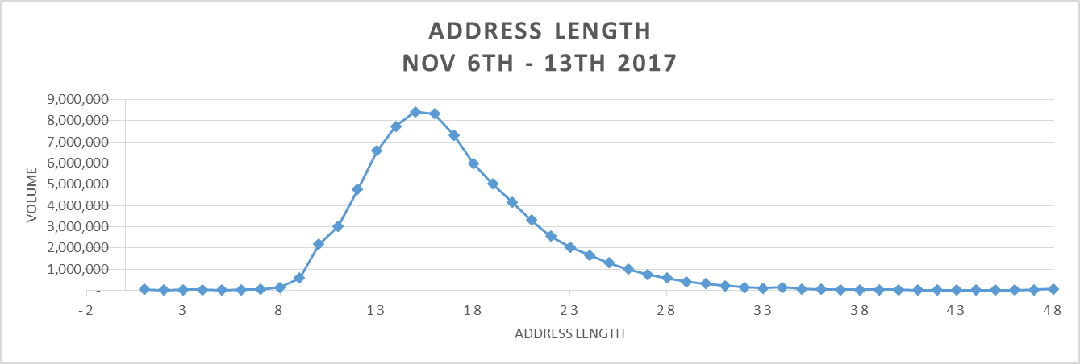
Industry Feedback:
Secondary Address Information
Industry Feedback | USPS Response
1. USPS provides a single 48-character field in Shipping Services File for Address Line 1 & Address Line 2 information With mail.dat and shipping services files both lines of address data has to be merged into a single field in the file. | Evaluated several options within the Shipping Services File and Shipping Partner File to provide additional character fields for address information. Providing mailers with additional character fields when an address exceeds the 48-character length maximum.
2. USPS does not follow ANSI standards which permits a minimum of two (2) address lines within a given segment of the file. | Currently researching if USPS follows the suggested N301 and N302 data segments as specified by ANSI .
Address Length Analysis:
Total volume for the week of November 6-13th, 2017- 79,505,763
  The most common character length was 16 (8,432,369 pieces)
    The majority of pieces trend between 14-17 characters
  79,300,776 pieces that used 40 characters or less making up .99% of the volume
  78,009 pieces that returned addresses using 48 characters, which makes up .01% of the volume

Slide 84
Industry Feedback:
Secondary Address Information
Industry Pain Point | USPS Response
3. Different understanding as to what level of information goes on delivery address line 1 vs. delivery address line 2 on an order form between Industry and USPS standards. | USPS Parcel Labeling Guide V2.0: The delivery address line should be limited to 40 characters. Suggested standard abbreviations to reduce the address line length to 40 characters or less can be found in Publication 28, Postal Addressing Standards. However, if all of the delivery address cannot fit in one line, then secondary address information can be placed immediately above the delivery address line.
4. Data analysis provided doesn’t show what is on the package label vs. what is available in the file (relative to secondary information), to identify why validation point failed. | Currently gathering data to show comparison of the delivery address information received in the file vs. the delivery address printed on the package label.
5. Address matching software handles multi-line information, and whatever information is provided on either address line, can be identified as either primary or secondary and USPS doesn’t provide that opportunity with a single address field. | Provided analysis and sample data during WG#185 sessions, showing the secondary information either at the beginning, end or twice on the delivery address line and correctly passing the validation criteria for address quality.

Slide 85
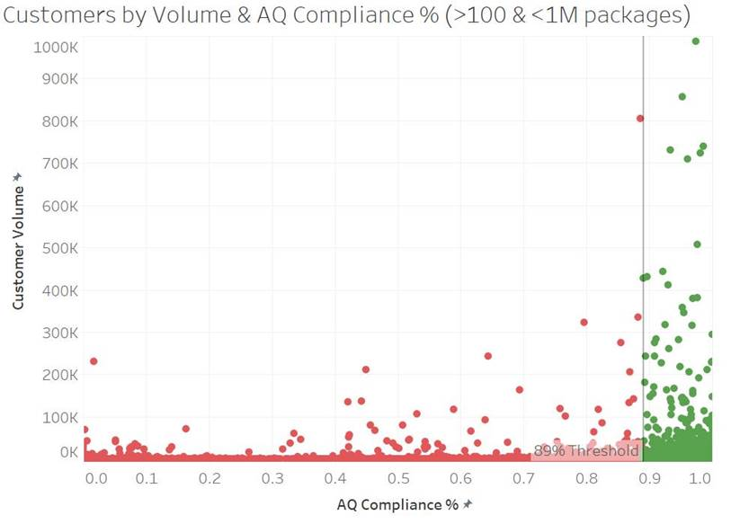
Address Quality Volume Analysis
October Address Quality Trends: Comparison of Package Volume to AQ Compliance Percentage
Above 89%
Below 89%

Slide 86
Appendix

Slide 87
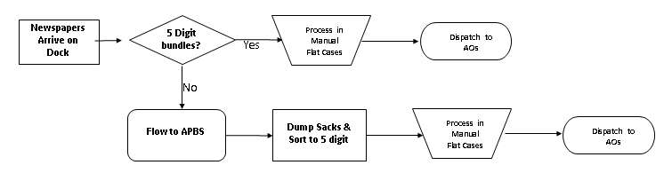
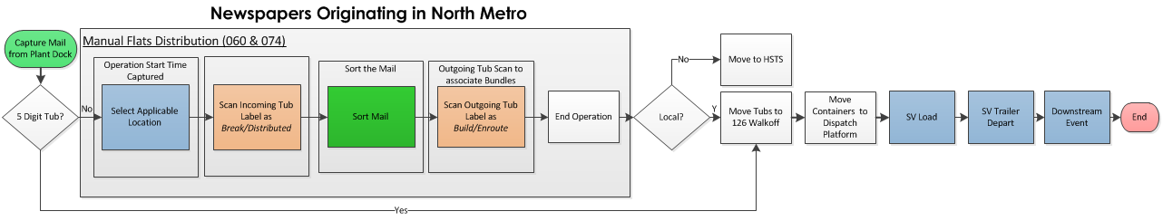
Process Flow of Visibility in
Newspaper Manual Operations
Expected Flow of Newspapers Originating in North Metro
Actual Flow of Newspapers Originating in North Metro

Slide 88


MTAC
November 30, 2017
Enterprise Analytics
Addressing & Geospatial Technology

Slide 89


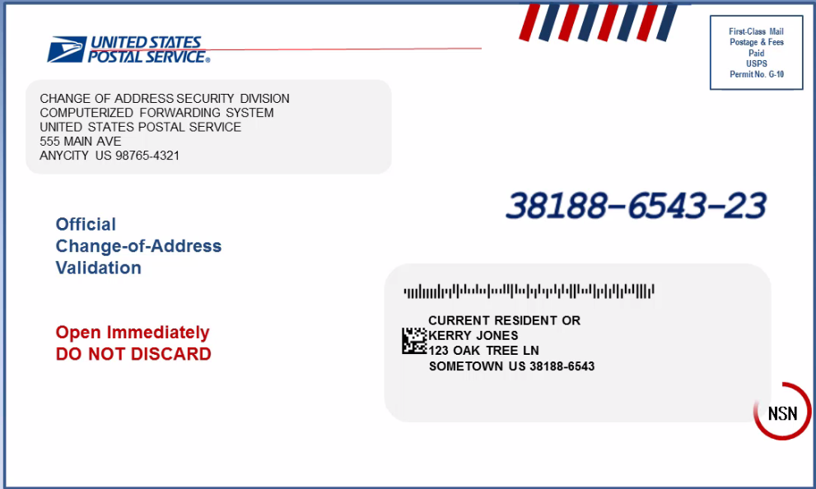
All Classes
Items for all classes:
CASS Cycle O planning
  Pre-PIT Meeting planned for January
  PIT Meeting in March 2018
  Cycle O release schedule will be announced after PIT
Overview of change-of-address correction process when
customer’s new address fails to match CASS™ / DPV (WG 185)
Discussion of R777 and No-Stat addresses (WG 186)
Remind employees of proper UAA procedures
  Updated and resent “Respect the Clear Zone” poster via Delivery
  Published “BlueTube™” Video covering UAA handling procedures
89

Slide 90
First-Class Mail®
First-Class Mail®
USPS Marketing Mail
Move Update 0.5% Threshold Concerns:
  Matching logic concerns may be addressed with NCOA^{Link} service provider/developer.
  NCOA^{Link} Name Presentation Reminder issued August 10, 2017.
  Evaluate errors based on Method(s) used.
    Need volunteers to share data and method(s)
  Diagnostics for Move Update errors limited
      NCOA^{Link} “match” data retention is restricted to 45 days
      MLOCR MSP retention of data for “no match” mailpieces is likely limited.
      Possible expansion of “00” table to include a flag for COA age > 90 days
  Late provisioning of ACS Data
      NCSC had six reported delays in FY 17, customers notified by email within 24 hours and resolved and data provided within 48 hours
90

Slide 91
First-Class Mail®
First-Class Mail®
USPS Marketing Mail
  “Carrier Identified” are counted as errors
      85% COA Letter Mail is Intercepted vs 15% Carrier ID
      All Flats are Carrier ID
October 2017 COA Errors | Total | CIF | INT
PARS | 5,581,607 | 636,943 | 4,944,664
FPARS/CFS/RFS | 22,809 | 22,809 | -
COA Error Total | 5,604,416 | 659,752 | 4,944,664
COA Error % |  | 11.8% | 88.2%
October 2017 ALL COAs | Total | CIF | INT
PARS | 125,089,059 | 16,265,891 | 108,823,168
FPARS/CFS/RFS | 5,032,247 | 5,026,237 | 6,010
ALL COA Total | 130,121,306 | 21,292,128 | 108,829,178
ALL COA % |  | 16.4% | 83.6%
91

Slide 92

Periodicals
Periodicals
ACS™ Reconciliation
  Retirement of the Periodical Reconciliation process effective January 2018 for February invoice.
  Full Service publishers that meet the 95% volume threshold will be charged for Traditional ACS record ONLY when they request Traditional ACS in the IMb.
PS Form 3579 notices
  Publisher’s must accept and pay for hardcopy notices unless they request ACS in the IMb.
  Traditional ACS Participant ID & Keyline font critical (Sans Serif with proper kerning)
Still seeing increase in manual ACS notification
92

Slide 93
Marketing Mail
Marketing Mail:
Issue with Marketing Mail UAA being incorrectly being returned
to mailer when processed on AFCS
  Solution is being currently tested by Engineering
93

Slide 94

Package Services
Package Services
New residence exclusion from IMpb™ Address Quality Compliance
Validate military address exclusion from IMpb Address Quality Compliance
Mapping of ACS™ event codes to PTR event level
A significant rise in miscoded parcels due to shipping software logic coding to the lowest ZIP Code within city & state
94

Slide 95
Thank You!
7

